Slide 1
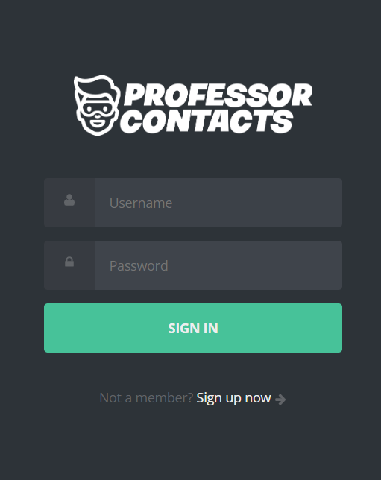
Professor Contacts
Contact Manager Small Project
Fall 2022, Leinecker

Slide 2

Jon Cirillo
Roles: Project Manager, Database
Joshua Samontanez
Roles: Frontend, API
The
Professor
Contacts
Team
Jason James
Roles: Frontend, API
Minh Ngo
Roles: Frontend, API
Ashlyn King-Chuparkoff
Role: Frontend

Slide 3












Technology Used
Communication and Version Control
Backend / Server
Frontend & IDEs
Notes:
Jason

Slide 4
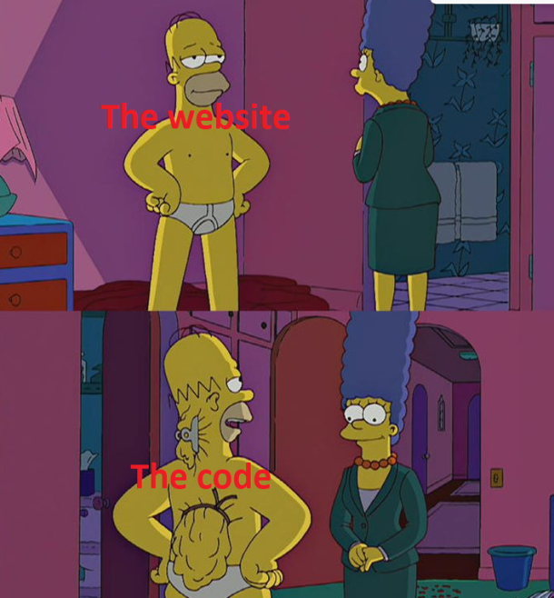
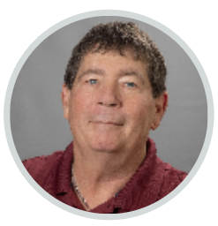

Slide 5

Successes:
Our website looks awesome (lol)
A lot was learned about full-stack development
Successes, Struggles, and Improvements
Struggles:
Deadlines and other coursework interference
Tasks were delegated as we went along
Domain wasn’t working at first
Lots of code to look at (~600 lines in code.js)!
Improvements:
New technical skills
Familiarized with new tools
This will make the large project easier from the get-go
Notes:
Jason: Successes
Ashlyn: Struggles
Minh: Improvements

Slide 6
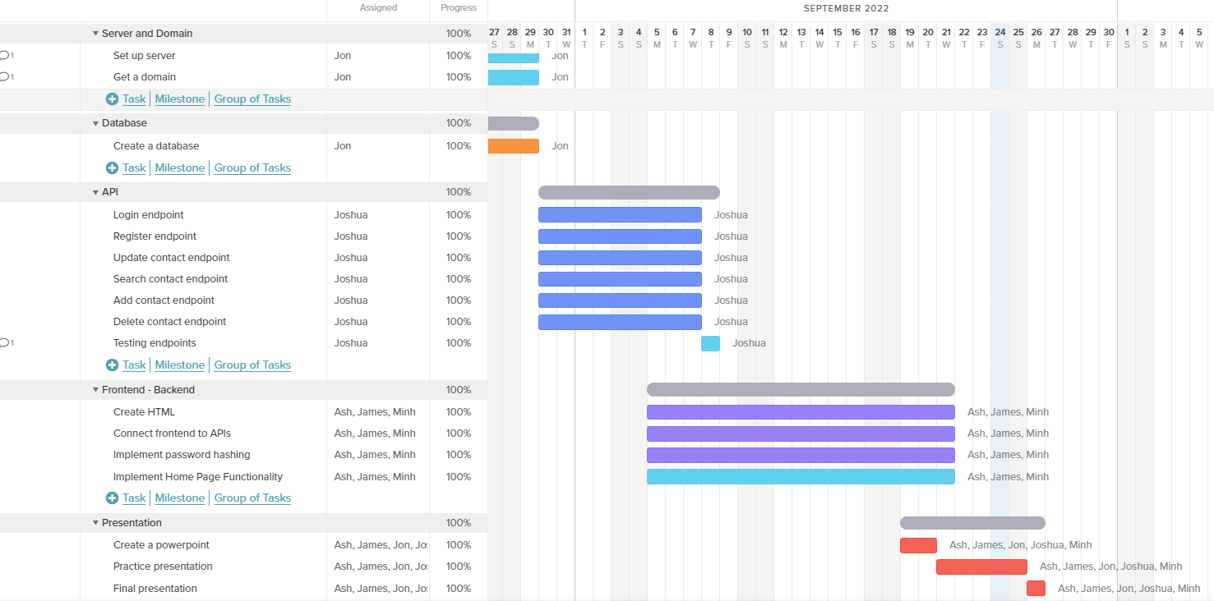
Gantt Chart

Slide 7
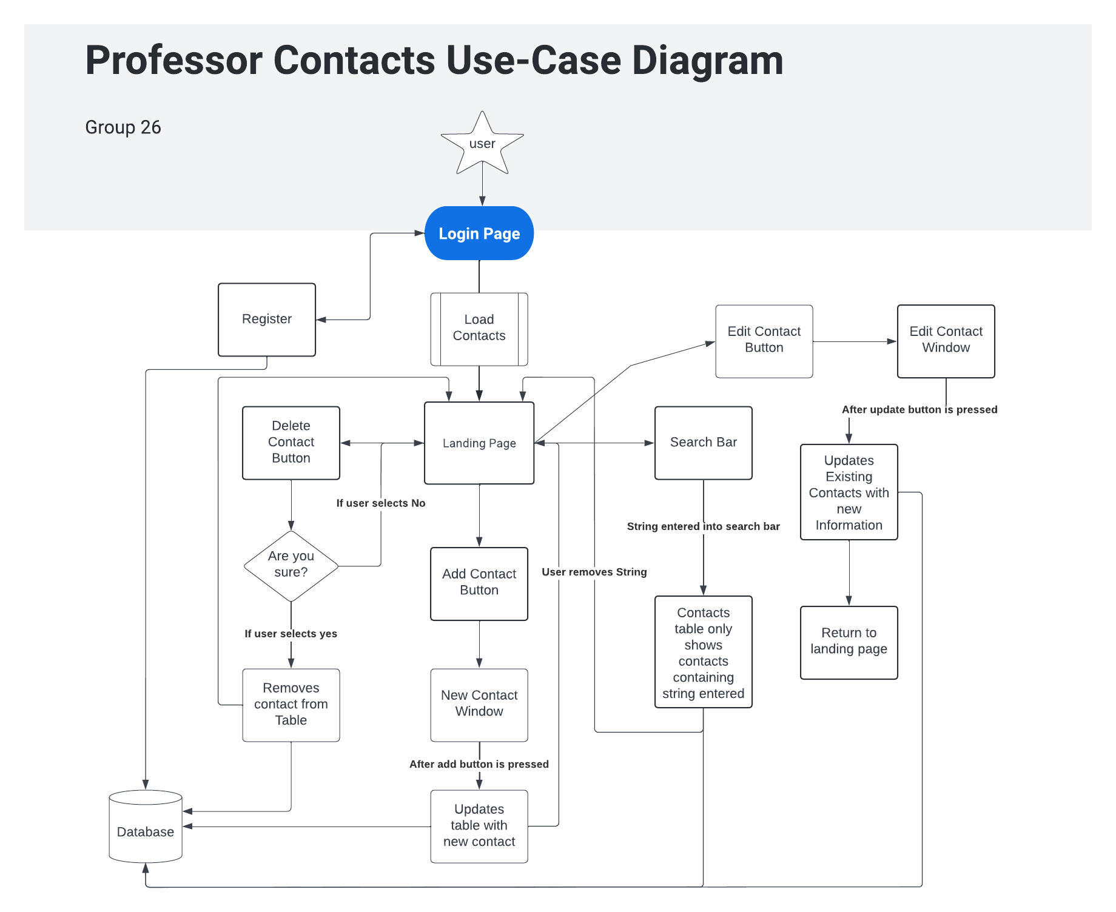


Slide 8
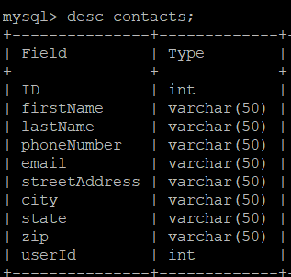
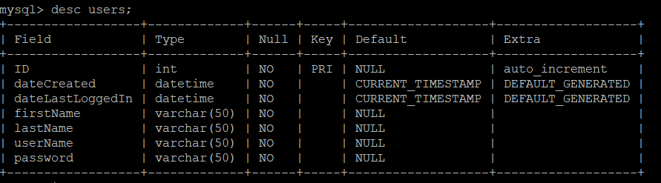
Database & ERD
Using MySQL:
Notes:
Jon

Slide 9
API Demo
Click Here
Notes:
https://app.swaggerhub.com/apis-docs/cachemoney-3000/Professor-Contacts-API-Documentation/1.0.0
Josh

Slide 10
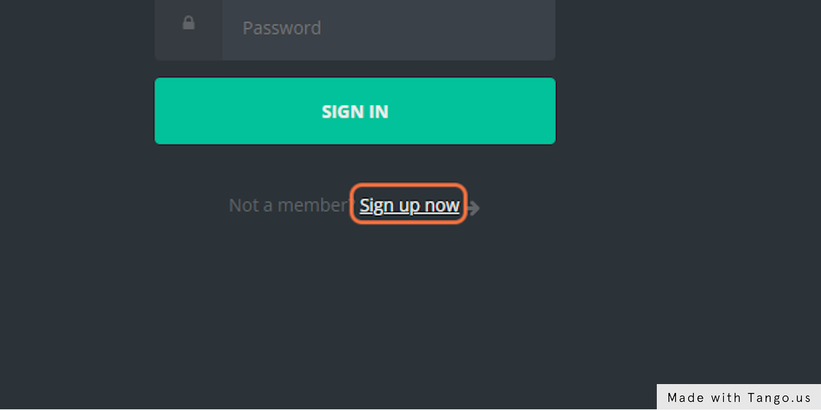
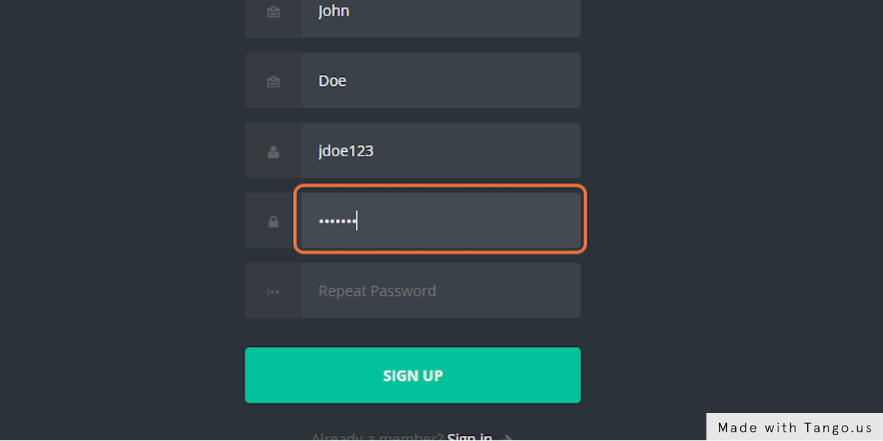
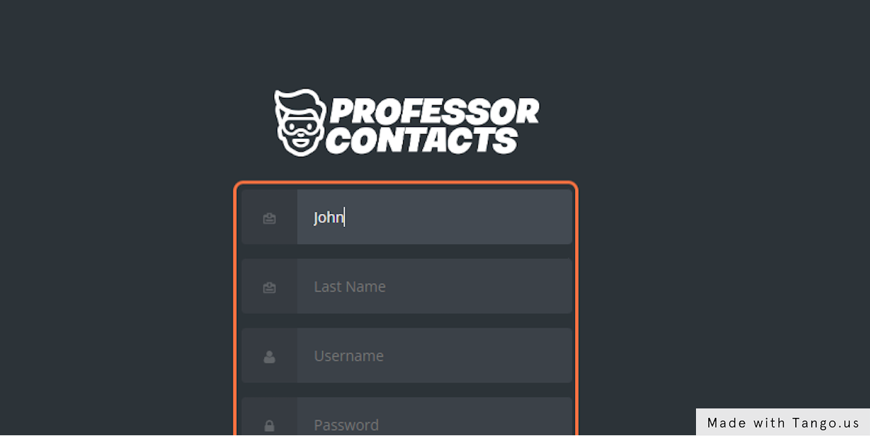
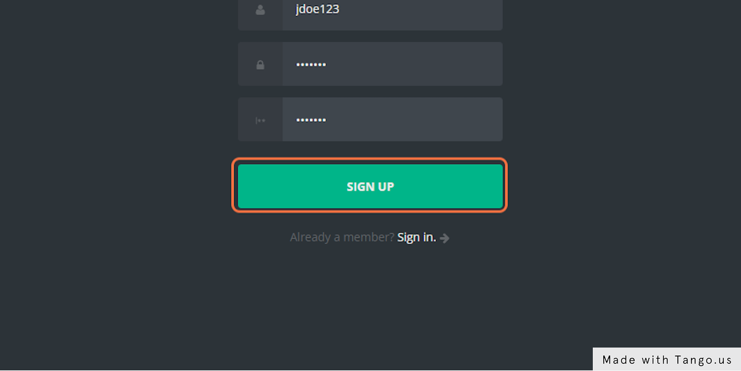
Sign Up
Click the “Sign up now” button
Create your own password
Complete the required
fields
Once done, click the “Sign Up” button
Notes:
Minh
No duplicate id

Slide 11
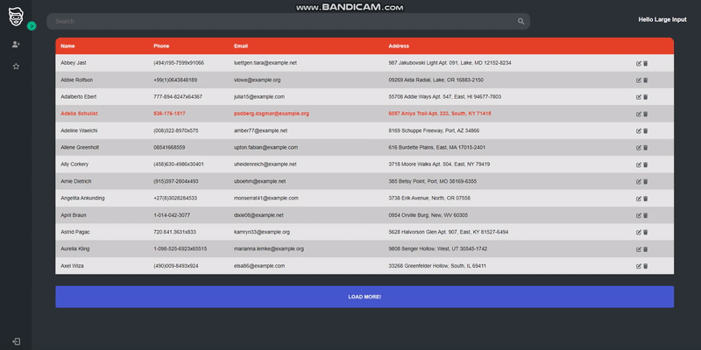
Lazy Loading
Allows the table to load 13 contacts more if the “LOAD MORE!” button is clicked
Notes:
User: largeinput
Pass: largeinput
Josh

Slide 12
App Demo
http://www.professorcontacts.com/
Notes:
https://app.swaggerhub.com/apis-docs/cachemoney-3000/Professor-Contacts-API-Documentation/1.0.0
Ashlyn

Slide 13
Are there any questions?

